Slide 1
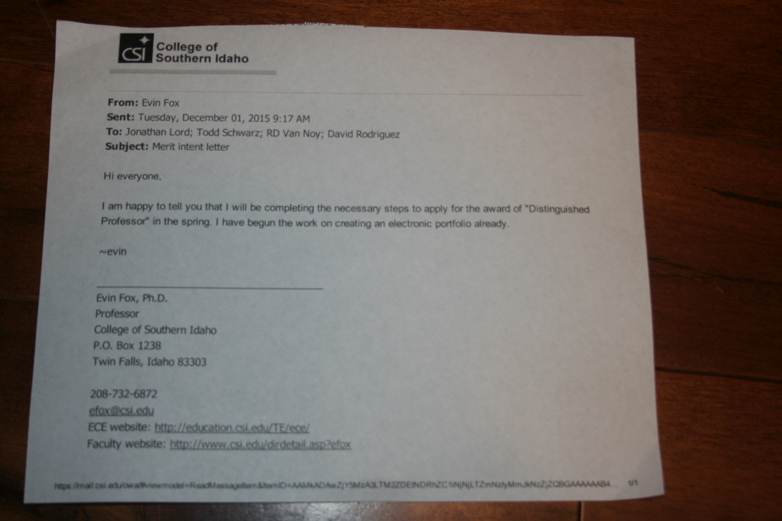

Slide 2
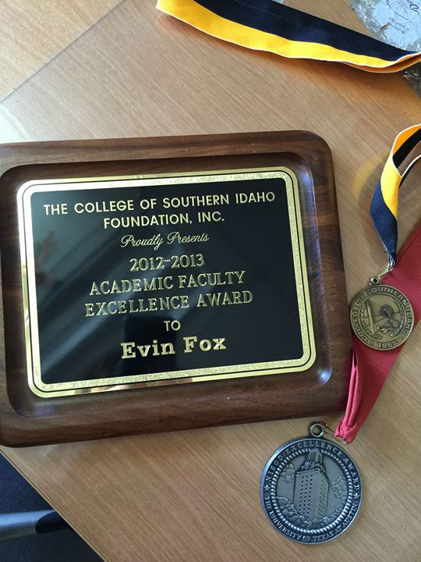

Slide 3
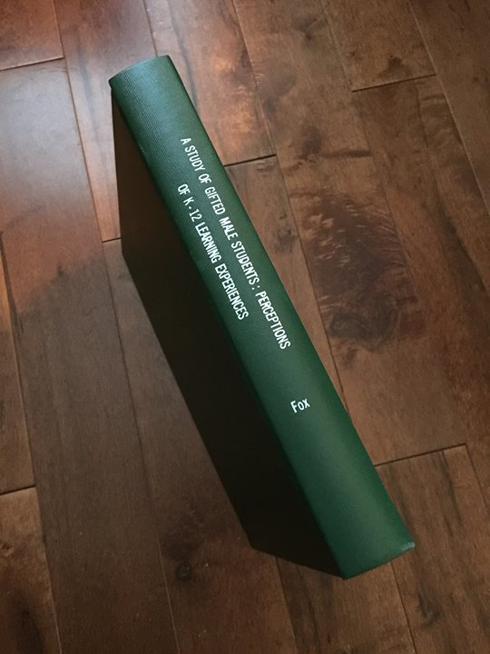
My dissertation on “Gifted Male Students.”

Slide 4
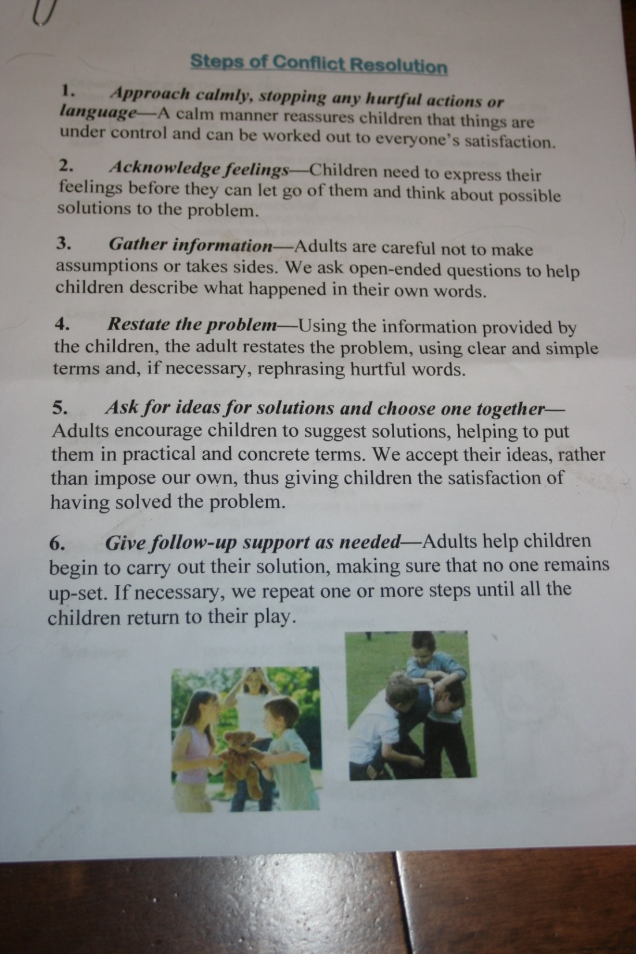

Slide 5
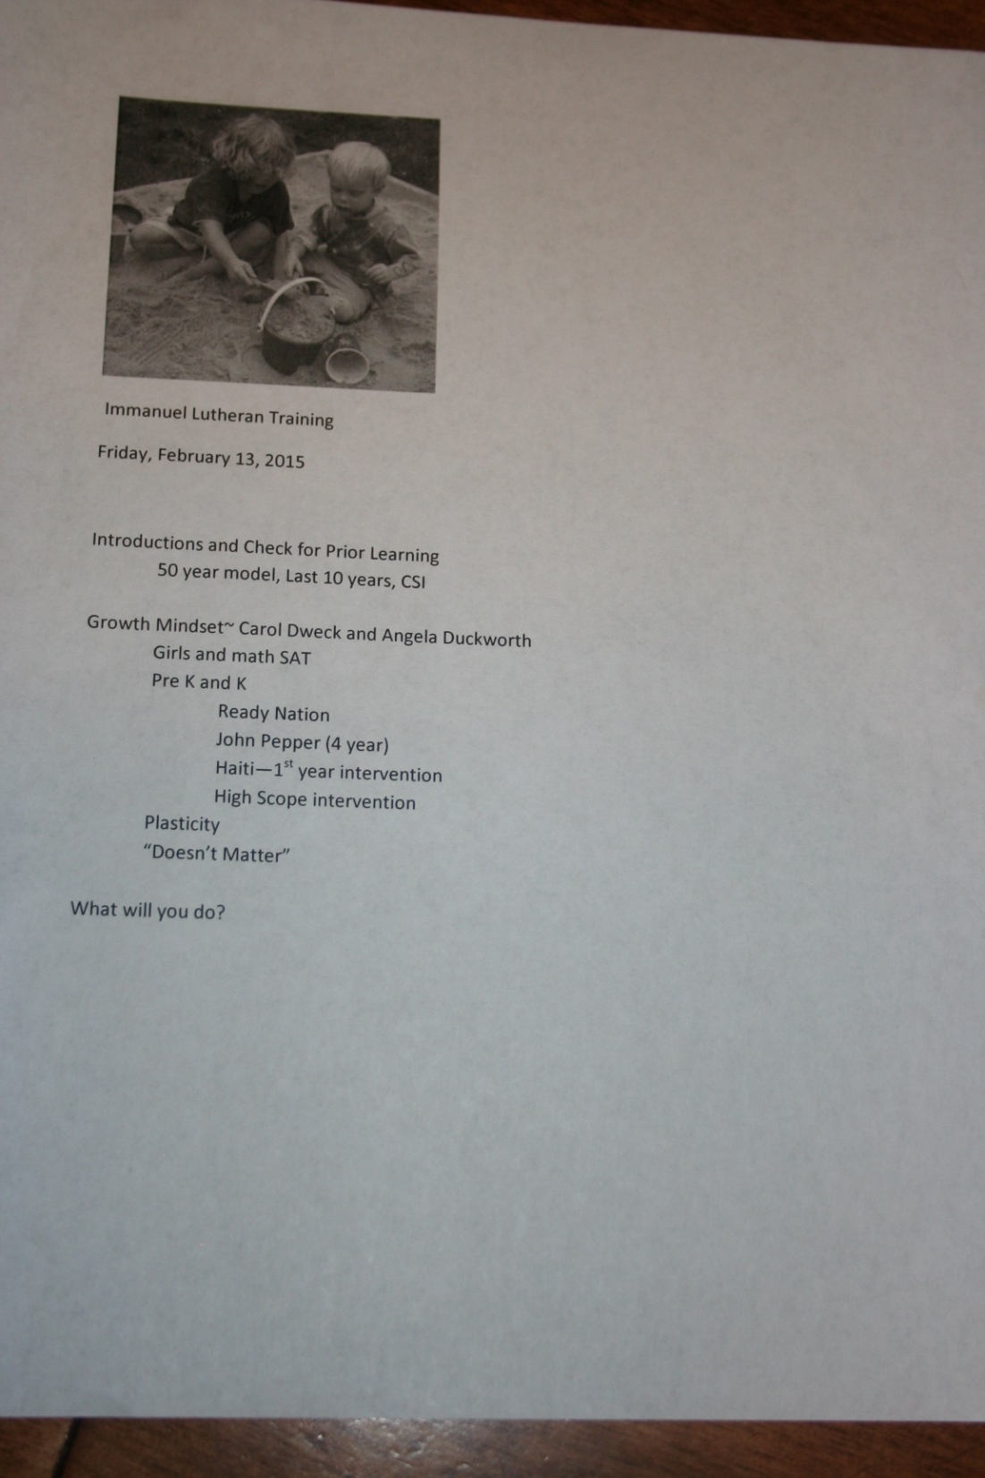
Ellen Neff and I presented a workshop for area educators.

Slide 6
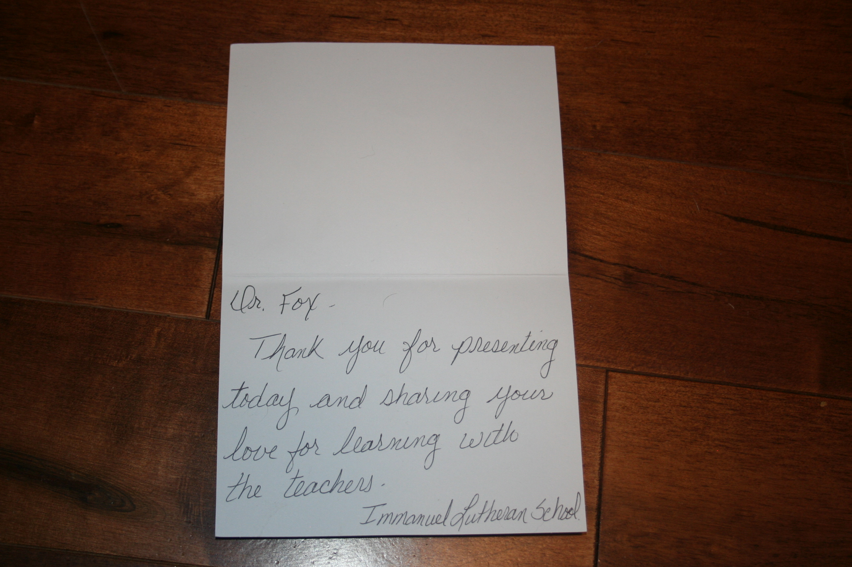

Slide 7
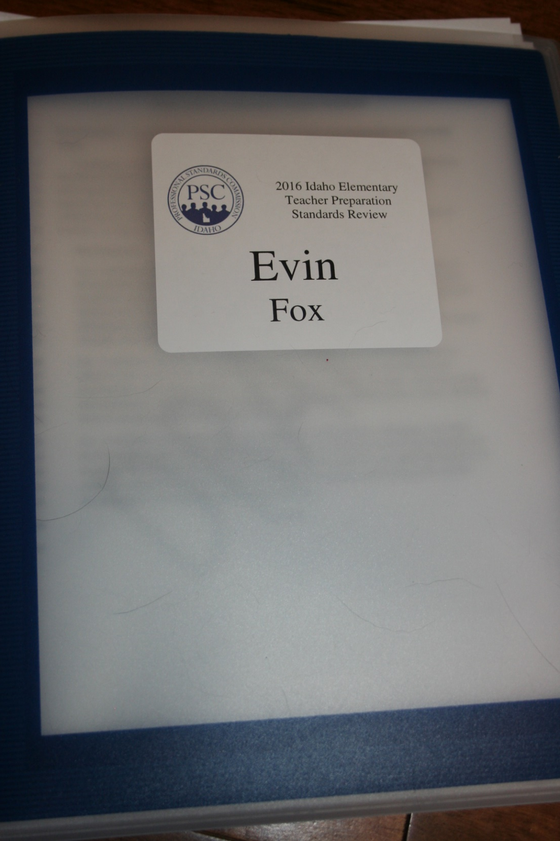
I was part of a committee to review Idaho Elementary Teacher Preparation Standards for the Professional Standards Commission in Boise, Idaho.

Slide 8
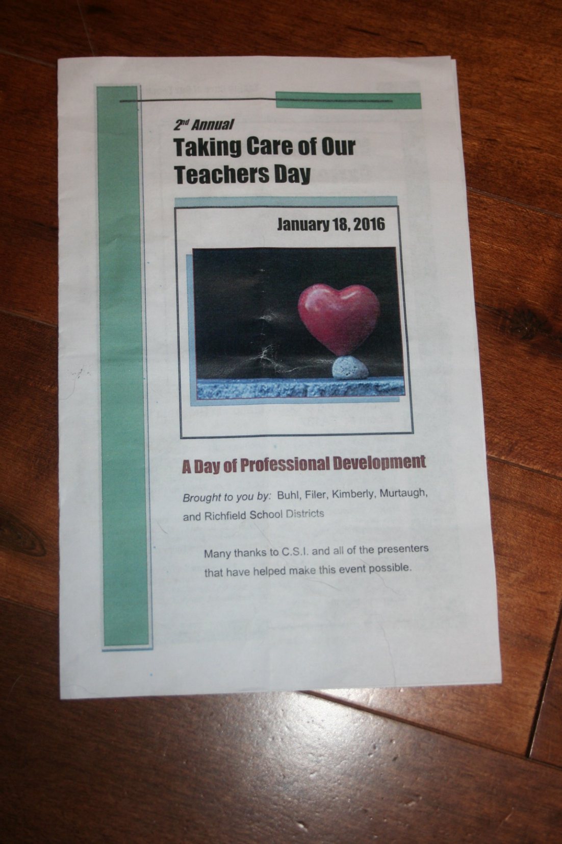
For 2 years, I have partnered with area schools to bring an inservice day to our community.

Slide 9
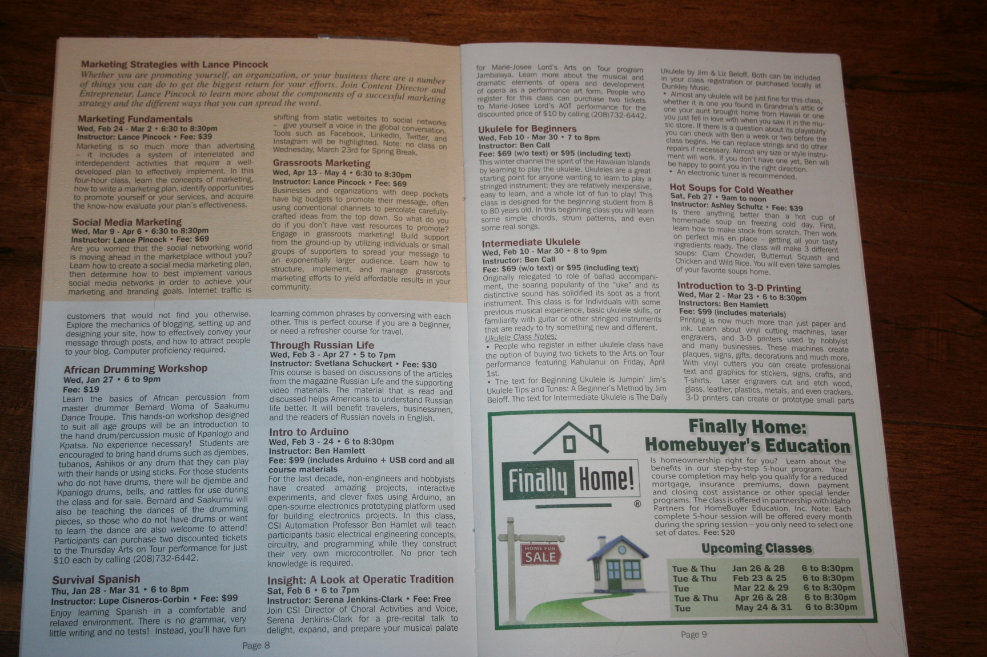

Slide 10
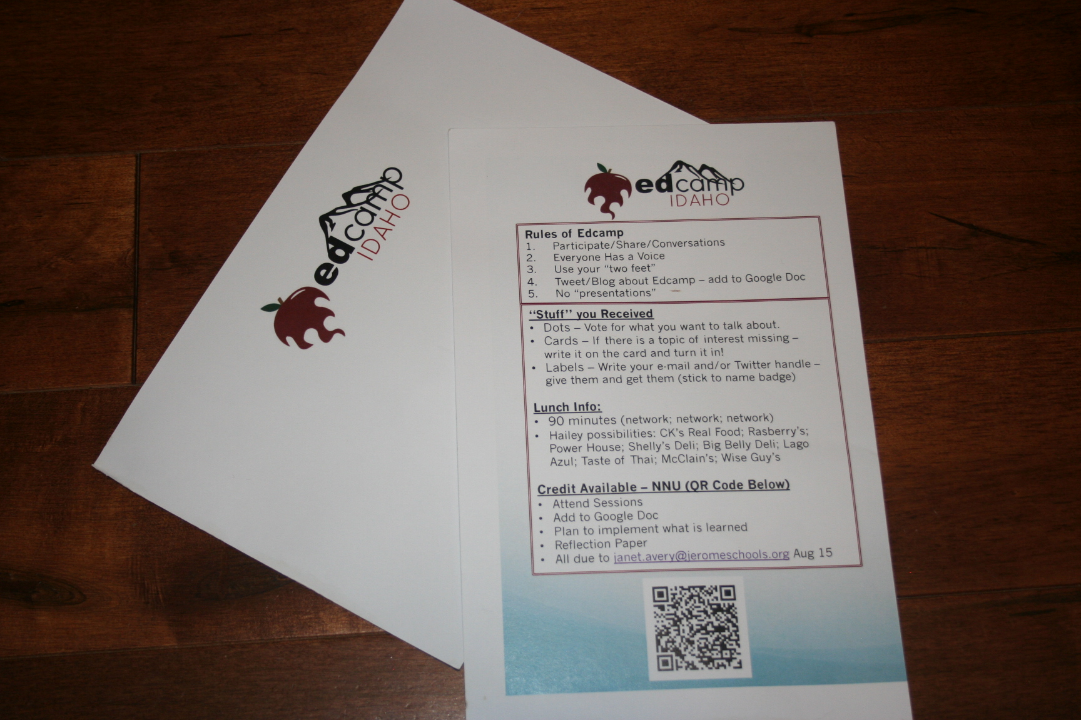
I like to participate in professional development opportunities.

Slide 11
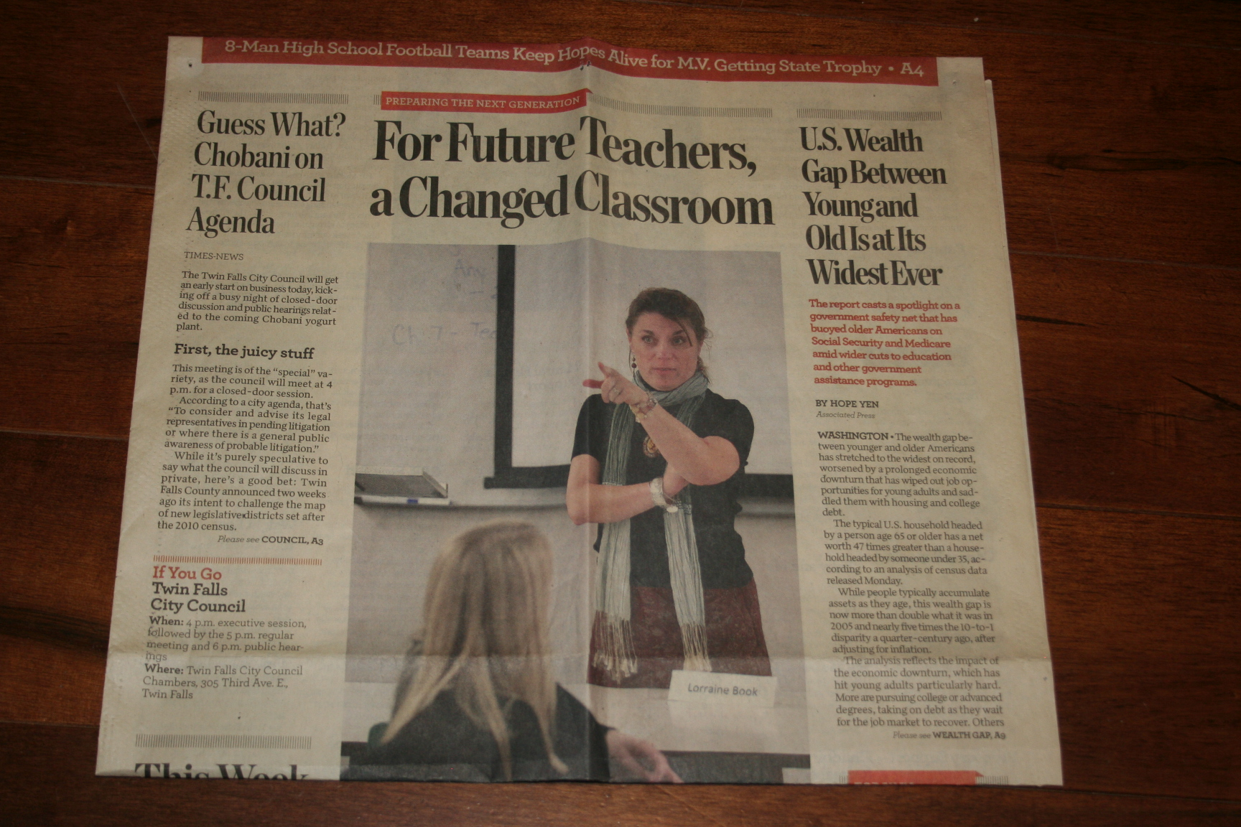
Technology is changing the way we teach.

Slide 12
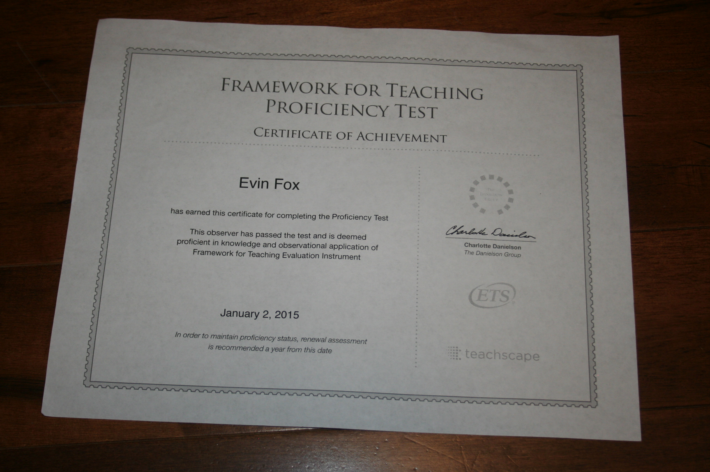
Idaho has a new framework for evaluating teachers. My colleagues and I attended this training and then completed the rigorous certification process. We find this important in keeping current in things we are teaching preservice teachers.

Slide 13
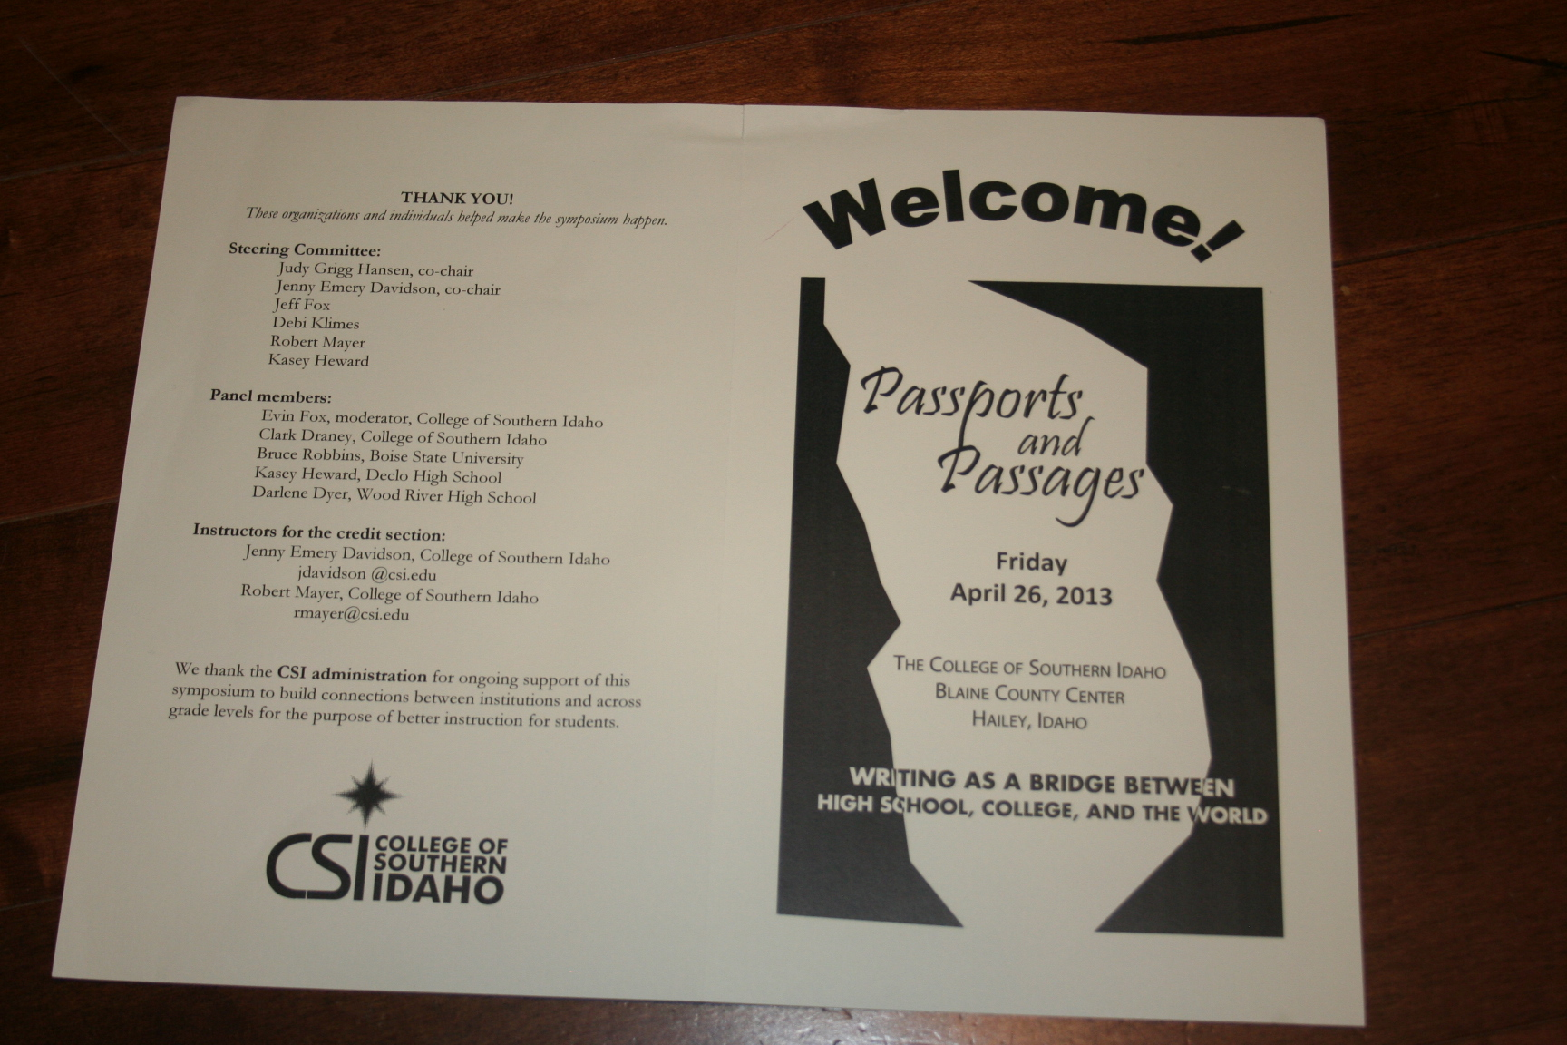
I try to attend conferences where I am collaborating and learning with my colleagues across the state and across the curriculum. I value this conference every year, and look at it as a “Thinking Conference.”

